Slide 1
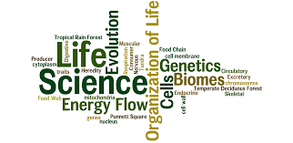
Chapter 1
The Study of Life

Slide 2
NOTES – COLOR CODING
BLUE – vocabulary terms
PURPLE – scientists
GREEN – theories
RED – steps and/or processes
colors will be used throughout the semester

Slide 3
BIOLOGY: A natural science concerning the study of life and living organisms, including their structure, function, growth, origin, evolution, distribution, and taxonomy
Numerous branches – some examples:
Zoology – the study of animal life
Botany – the study of plant life
Microbiology – the study of microorganisms
Ecology – the study of organisms and their environment
Anatomy – the study of the structure of living organisms
Physiology – the study of animal function
“bio” = “life”
“-logy” = “science of; study of”

Slide 4
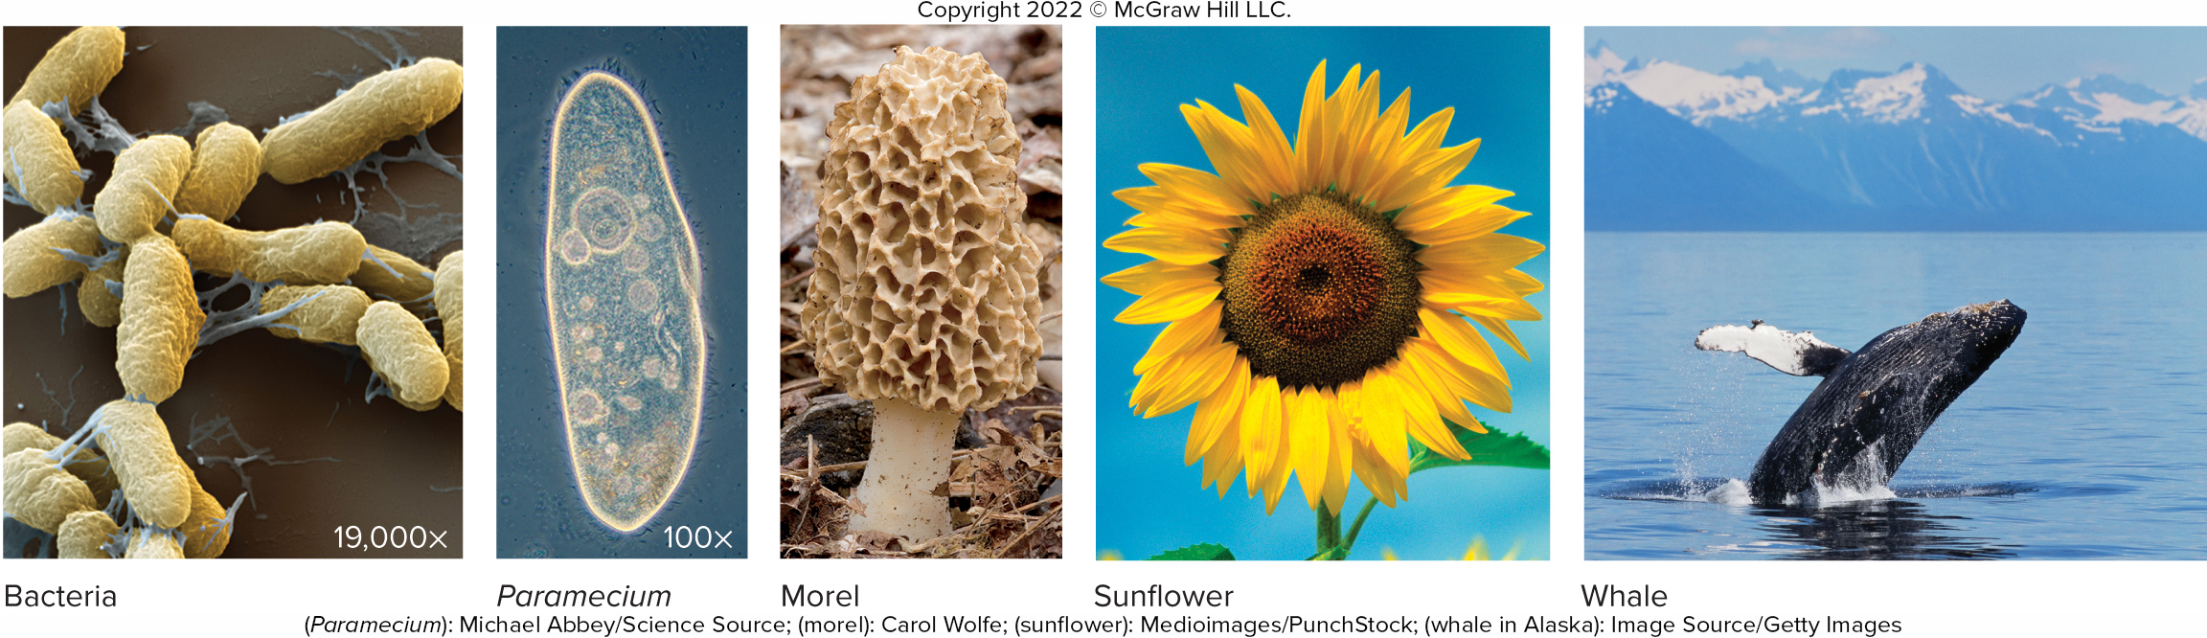
LIFE IS DIVERSE
Range in size from microscopic bacteria to 300-ft tall giant sequoia trees and 40-ton humpback whales
Estimated 8.7+ million species on the planet excluding bacteria. Bacteria would double that number.
Life is defined by Characteristics of Life which distinguish living organisms from non-living things.

Slide 5
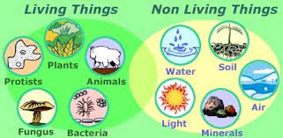
CHARACTERISTICS OF LIFE
Organized
Requires energy
Maintains Homeostasis
Responds to Stimuli
Reproduces and Develops
Adapts and Evolves
Used to distinguish living organisms from non-living things

Slide 6
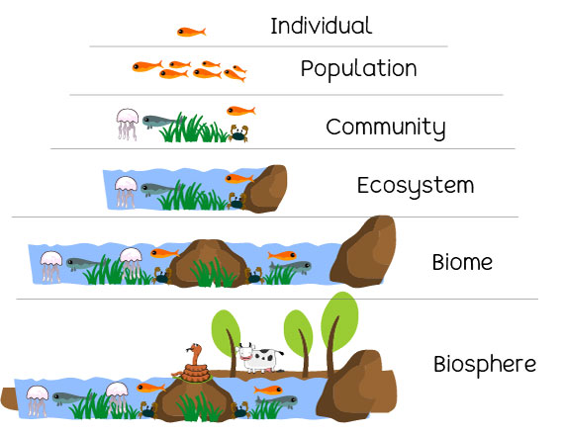
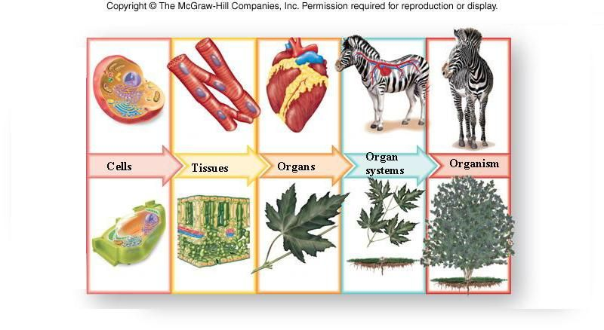
LIFE IS ORGANIZED…
Outside the organism:
Inside an organism:
https://eschooltoday.com/learn/wp-content/uploads/2020/10/levels-of-organisations-in-an-ecosystem.jpg

Slide 7
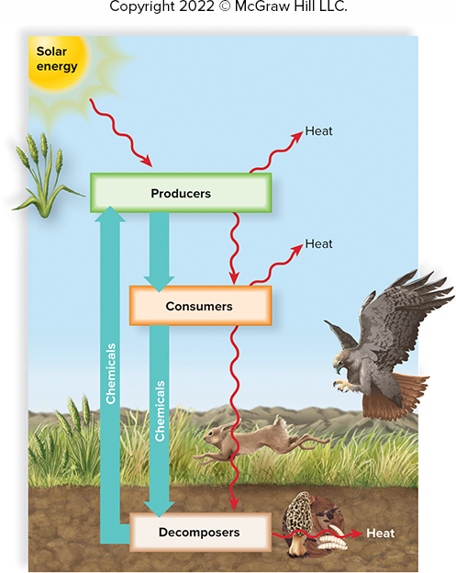
LIFE REQUIRES ENERGY…
FLOW OF ENERGY
It takes work and energy to maintain the organization of cell and organism
Energy – the capacity to do work
Photosynthesis – in producers, use of solar energy to produce chemical energy (food)
Metabolism – in all organisms, chemical reactions convert food into energy

Slide 8
LIFE MAINTAINS HOMEOSTASIS…
a state of biological balance
“homeo-” = “same, steady”
“-stasis” = “controlling, constant”
To survive, organisms must keep certain physiological factors (temperature, moisture level, acidity, etc.) within a constant, tolerable level.
Examples:
When glucose levels rise, pancreas releases insulin to signal liver to convert glucose into storable glycogen. When glucose levels drop, liver converts glycogen back into glucose.
The nervous system controls breathing rate to ensure your body is receiving the appropriate amount of oxygen.
Your body maintains a steady body temperature. You may sweat to release excess heat or shiver to produce heat.

Slide 9
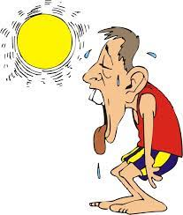
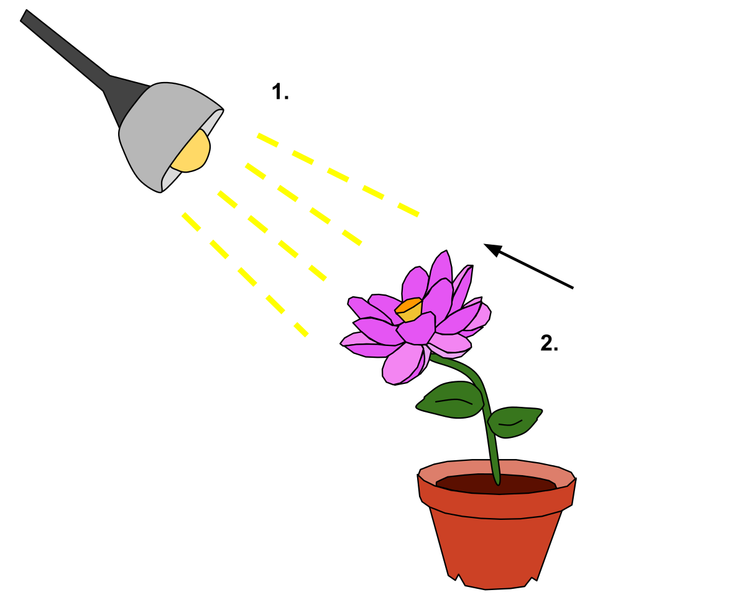
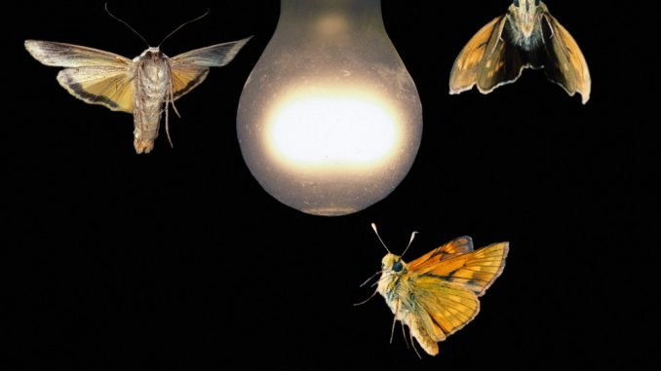
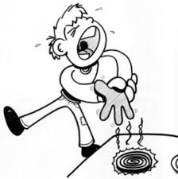
LIFE RESPONDS TO STIMULI…
chemical or physical change in internal or external environment, causes a response from the organism
Closely connected to homeostasis
Examples:
Moths are attracted to light – light is the stimulus
Pulling back from a hot stove – hot stove is the stimulus
Plants grow towards light – light is the stimulus
https://onlinesciencenotes.com/wp-content/uploads/2018/10/taxis-678x381.jpg
https://encrypted-tbn0.gstatic.com/images?q=tbn:ANd9GcSeLKQ8yp4jeW6-Ve2yKXCQ3KIvNW8u0mbKJA&usqp=CAU
https://upload.wikimedia.org/wikipedia/commons/thumb/1/1f/Phototrophic_Response_to_Stimulus.svg/1200px-Phototrophic_Response_to_Stimulus.svg.png

Slide 10
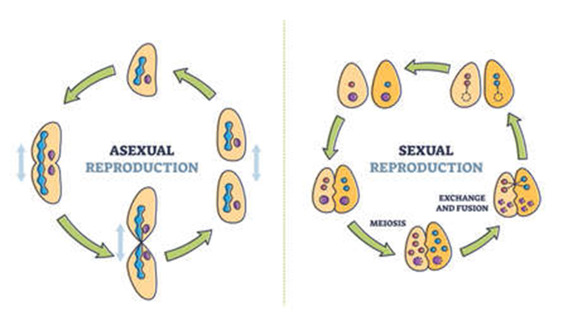
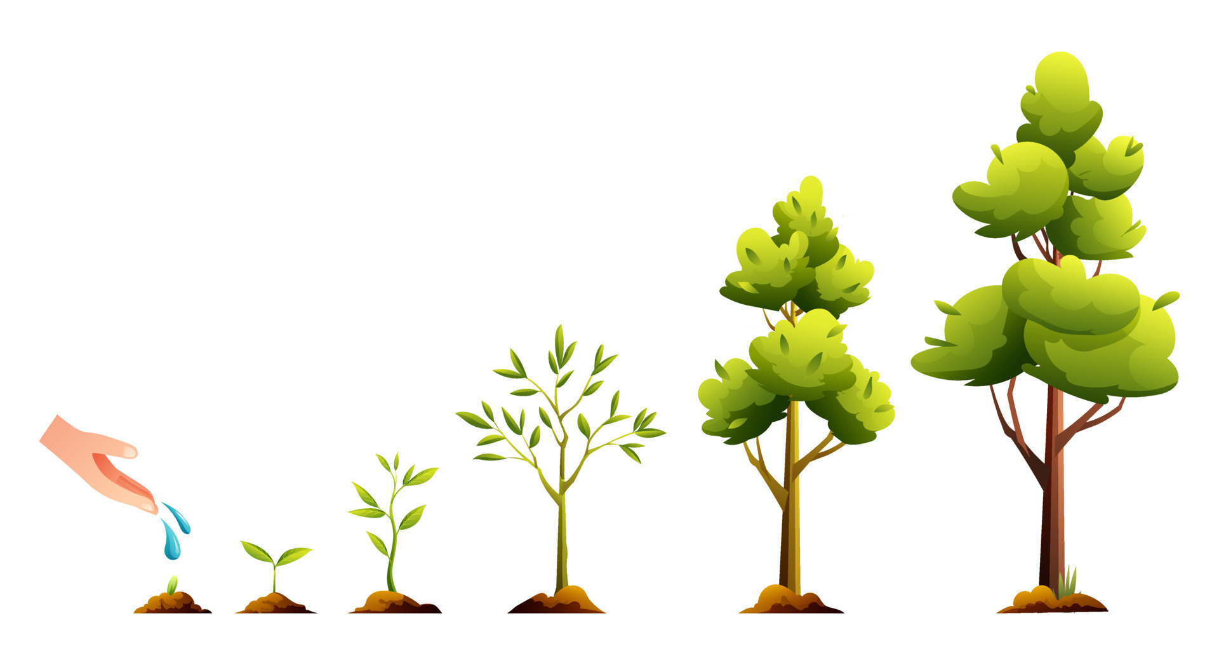
LIFE REPRODUCES AND DEVELOPS…
Reproduction – producing new individual of same kind
Genetic information (DNA) is passed to new individual
Development – process of growth and differentiation of cells and tissues
Each new cell is transformed through series of stages

Slide 11
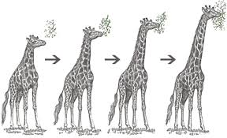
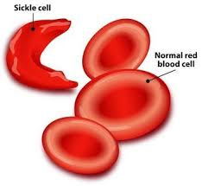
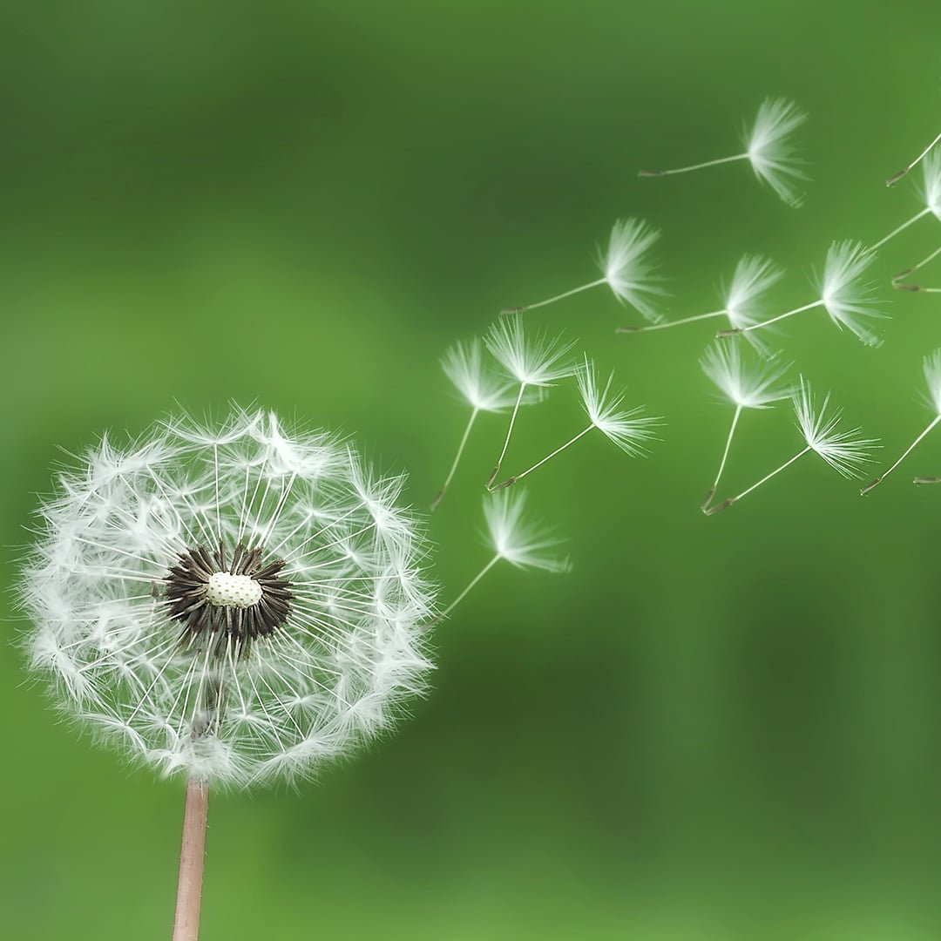
LIFE ADAPTS AND EVOLVES…
Adaptation – modifications that make one organism better fit to function and survive in a particular environment
Evolution – the way a population changes over many generations to become more suited to their environment
Better suited for wind dispersal of seeds, not reliant on animals
Better suited to feed from tops of trees, above other organisms
Better suited to areas of malaria, survive infection

Slide 12
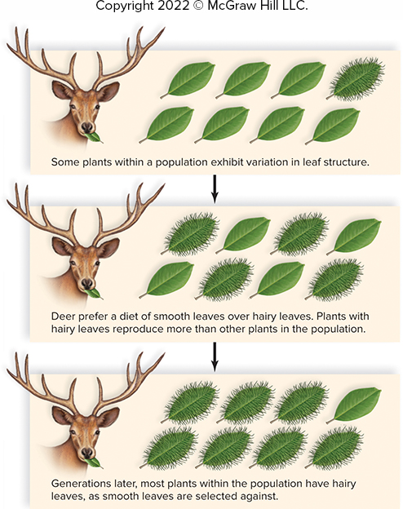
NATURAL SELECTION
Specific characteristic
Better suited for environment
Survive and reproduce
Organism can survive and pass this characteristic on to future generations.
SURVIVAL OF THE FITTEST

Slide 13
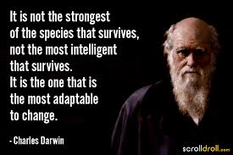
CHARLES DARWIN
1809 – 1882
English naturalist
Laid foundation of evolution based on his theory of natural selection
Formulated his theory in 1839 after voyage around the world on HMS Beagle (his ship)
Published his theory in 1859 in his book On the Origin of Species
GREATEST CONTRIBUTION:
Theory of Evolution:
Individuals of species are not identical
Traits are passed down from generation to generation
More offspring are born than can survive
Only survivors of competition for resources will reproduce

Slide 14
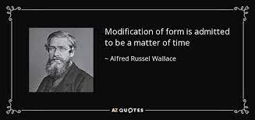
ALFRED WALLACE
1823 – 1913
British naturalist, explorer, geographer, biologist, and anthropologist
Proposed theory of evolution by natural selection in 1858
Prompted Darwin to present his ideas
Wallace and Darwin co-authored a publication in 1858
The success of On the Origin of the Species overshadowed Wallace’s contributions
GREATEST CONTRIBUTIONS:
8 year excursion to Dutch East Indies (Indonesia)
Developed natural selection theory
Discovered thousands of new species of beetles

Slide 15

POSSIBLE TEAS QUESTION
Which of the following are examples of homeostatic mechanisms?
Consuming excess calories to gain weight
Lifting weights to increase muscle mass
Shivering when the body temperature falls
Secreting insulin to decrease blood sugar concentration
Increasing heart rate when blood pressure is low

Slide 16
POSSIBLE TEAS QUESTION
Which of the following are examples of homeostatic mechanisms?
Consuming excess calories to gain weight
Lifting weights to increase muscle mass
Shivering when the body temperature falls
Secreting insulin to decrease blood sugar concentration
Increasing heart rate when blood pressure is low

Slide 17
CLASSIFICATION OF LIFE
Because life is so diverse, it is helpful to group organisms into categories.
Taxonomy – study of naming, describing, and classifying organisms
“taxo-” = “arrange”
“-nomy” = “usage”
Systematics – study of evolutionary relationships and shared traits
Examples:
Animals that lay eggs and have scales are grouped together as reptiles.
Animals that have live births and hair/fur are grouped together as mammals.
NOT A PERFECT SYSTEM!

Slide 18
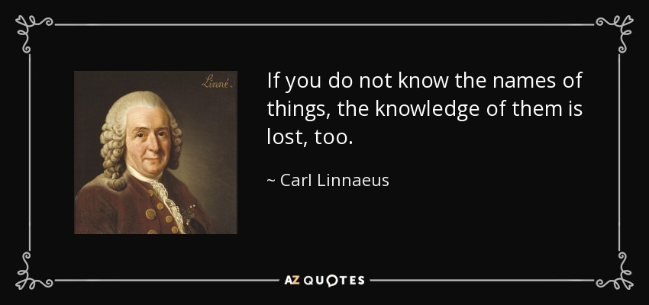
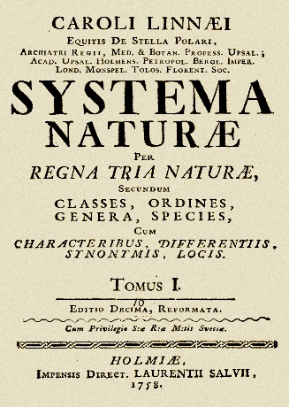
CARL LINNAEUS
1707 – 1778
Swedish botanist, zoologist, taxonomist, and physician
Originator of modern classification system
Named 4,400 animal species and 7,700 plant species
Authored over 180 works, but most notable is his Systema Naturae
GREATEST CONTRIBUTIONS:
Binomial Nomenclature: a naming system in which each species is assigned a two-part name
Developed a hierarchal system for classifying organisms
Father of Taxonomy

Slide 19
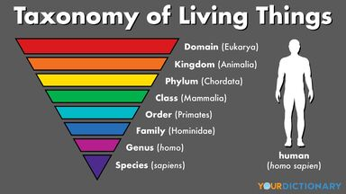
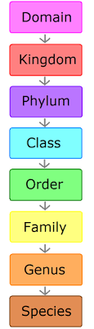
8 LEVELS OF CLASSIFICATION
Dumb
King
Phillip
Came
Over
For
Good
Soup

Slide 20
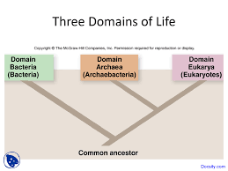
DOMAINS
Bacteria
Prokaryotic cells
Unicellular
Vital decomposers in every habitat
Archaebacteria
Prokaryotic cells
Unicellular
Live in extreme environments
Eukaryotes
Eukaryotic cells
Unicellular or multicellular
Includes protists, fungi, plants, and animals

Slide 21
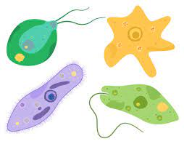
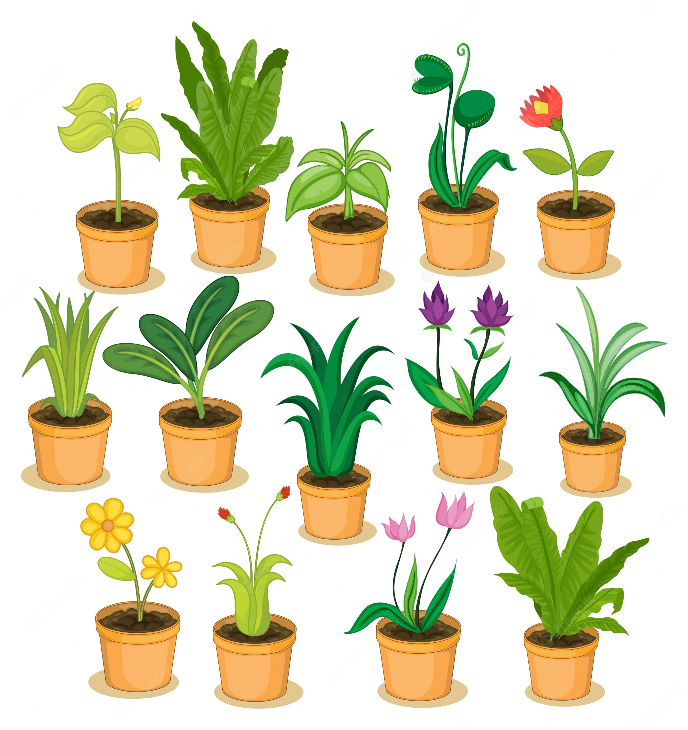
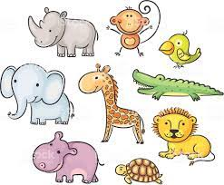
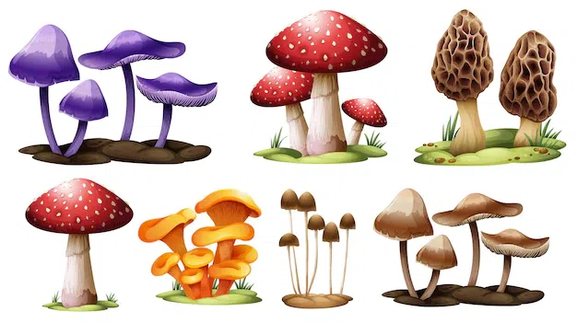
KINGDOMS Under the Domain Eukarya
PROTISTS
Unicellular
Absorb, photosynthesize, or ingest food
Algae, protozoans, slime molds and water molds
PLANTS
Multicellular
Photosynthesize food
Mosses, ferns, conifers, flowering plants
FUNGI
Multicellular
Absorb food
Molds, mushrooms, yeast, and ringworms
ANIMALS
Multicellular
Ingest food
Reptiles, mammals,
amphibians, birds,
fishes

Slide 22
POSSIBLE TEAS QUESTIONS
Which taxonomic rank is the next smallest after Order?
Phylum
Family
Species
Genus
Cheetahs, rainbow trout, and inchworms belong to the same
kingdom
phylum
class
order

Slide 23
POSSIBLE TEAS QUESTIONS
Which taxonomic rank is the next smallest after Order?
Phylum
Family
Species
Genus
Cheetahs, rainbow trout, and inchworms belong to the same
kingdom
phylum
class
order

Slide 24
BINOMIAL NOMENCLATURE
Each living organism assigned two-part name
“bi-” = “two”
“-nomial” = “terms”
“nomenclature” = “assigning of names”
Genus
First word
Capitalized
A group of closely related species
Species
Second word
Lowercase
A group of similar individuals capable of interbreeding or exchanging genes
Rules for writing scientific names:
When typed, italicize.
Staphylococcus aureus
When handwritten, underline.
Staphylococcus aureus
To abbreviate:
Genus name can be abbreviated as one letter, if it had been stated previously
Staphylococcus aureus = S. aureus

Slide 25
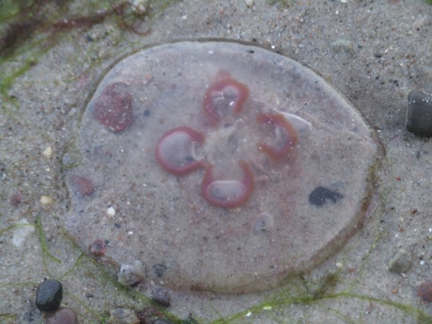
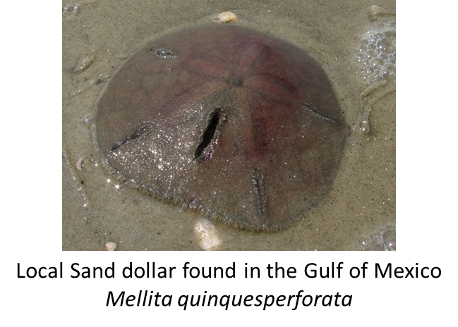
Moon Jellyfish
Aurelia aurita
Sample Test Question:
If the common bottlenose dolphin species truncates found in the Gulf of Mexico belongs to the tursiops genus of dolphin. The genus Tursiops is distinguished by a short, well-defined snout or beak which is about 8 cm long and apparently resembles the top of an old-fashioned gin bottle (hence the name). Tursiops have larger brains than those of humans and shows a high degree of "intelligence.“ Write the scientific name for the bottlenose dolphin in the proper format.
Tursiops truncates

Slide 26
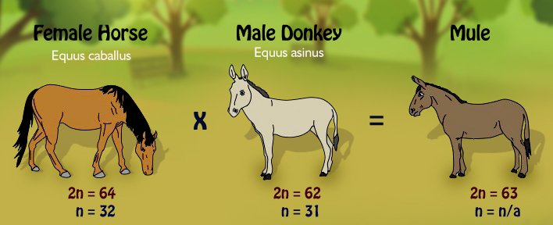
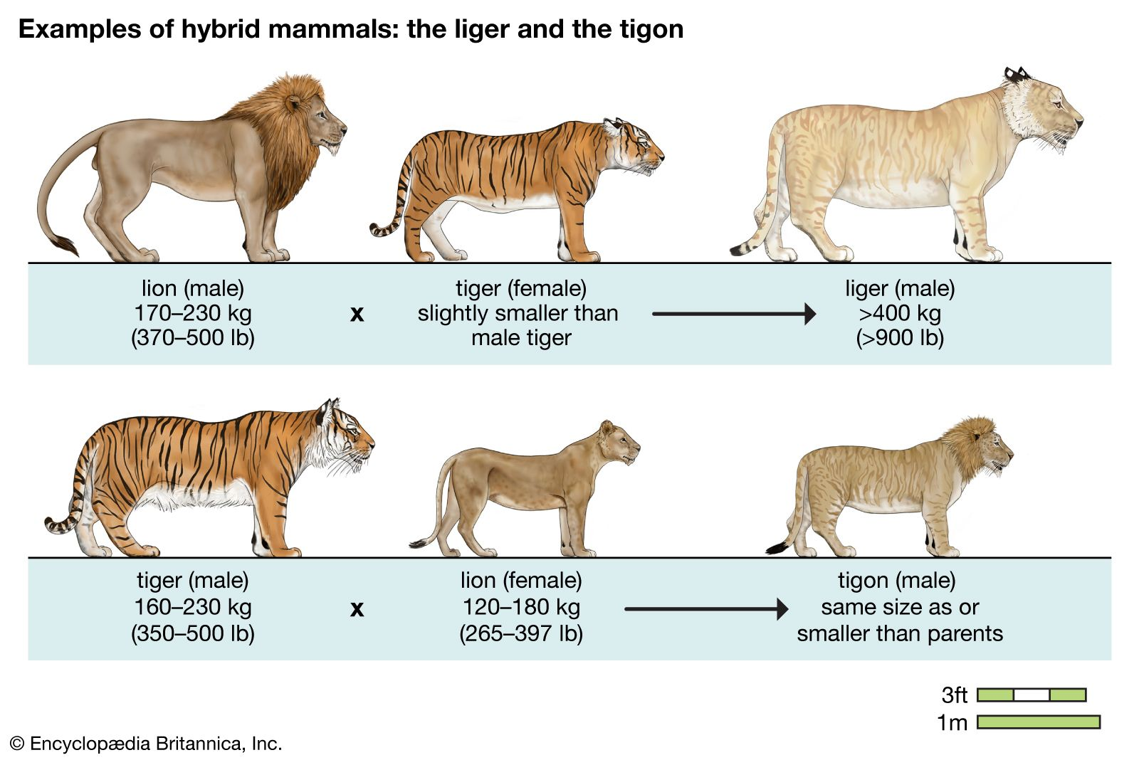
SPECIES
EXAMPLES – 2 different species mating:
Horse + Donkey = Mule (infertile)
Lion + Tiger = Liger (infertile)
Group of similarly constructed organisms capable of interbreeding and producing fertile offspring
“Fertile offspring” are able to reproduce.
If two organisms cannot mate and produce fertile offspring naturally, they are not in the same species!

Slide 27
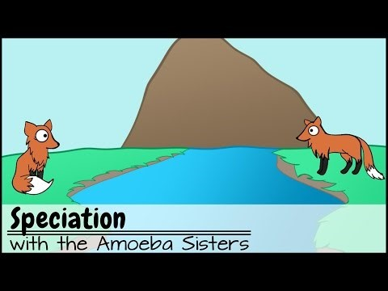
SPECIATION
An evolutionary process that results in the formation of a new species
Modes of Speciation:
Allopatric – due to geographic isolation
Sympatric – occurs in same location/habitat
Reproductive Isolating Mechanisms:
Prezygotic – occurs before or prevents fertilization of the egg
Postzygotic – occurs after fertilization of the egg

Slide 28
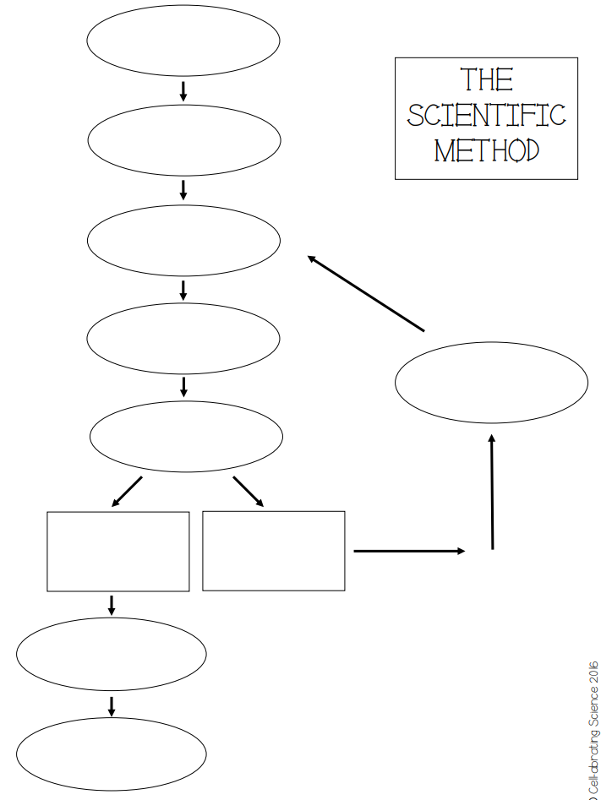
THE SCIENTIFIC METHOD
A standard series of steps used to gain new knowledge that is widely accepted among scientists
Acts as a guideline for scientific studies
May be modified or adapted to suit a particular field of study

Slide 29

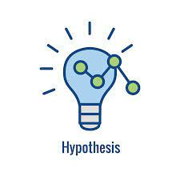
STEPS OF THE SCIENTIFIC METHOD
OBSERVATION
HYPOTHESIS
Collect and record current information, used to construct hypothesis
Includes scientist’s own prior knowledge
Can incorporate the knowledge and experiences of other scientists
Possible explanation
An informed statement that can be tested
Three types of hypotheses:
Directional – predicts a positive or negative change
Non-directional – predicts a change, but is not specific
Null – predicts no change will occur

Slide 30
STEPS OF THE SCIENTIFIC METHOD
EXPERIMENTATION
Hours Spent Studying
(Independent)
Series of procedures designed to collect data for testing a hypothesis
Involves “if, then…” logic – searching for cause and effect relationship
Proper design includes testing one specific variable at a time
Experiment Variables
Independent variable – factor being tested, applied only to experimental group
Dependent variable – result of independent variable
Controlled variables – all factors not changed
Exam Score (Dependent)

Slide 31


STEPS OF THE SCIENTIFIC METHOD
CONCLUSION
DATA/RESULTS
Data is examined to determine if hypothesis is supported
If prediction occurs, hypothesis is supported.
If prediction does not occur, hypothesis is rejected.
Scientists report their findings in scientific publications
Peer-reviewed to ensure research is credible, accurate, and unbiased
Facts or information collected through experiment
May be presented as tables or graphs
Analyzed using statistics to determine validity

Slide 32
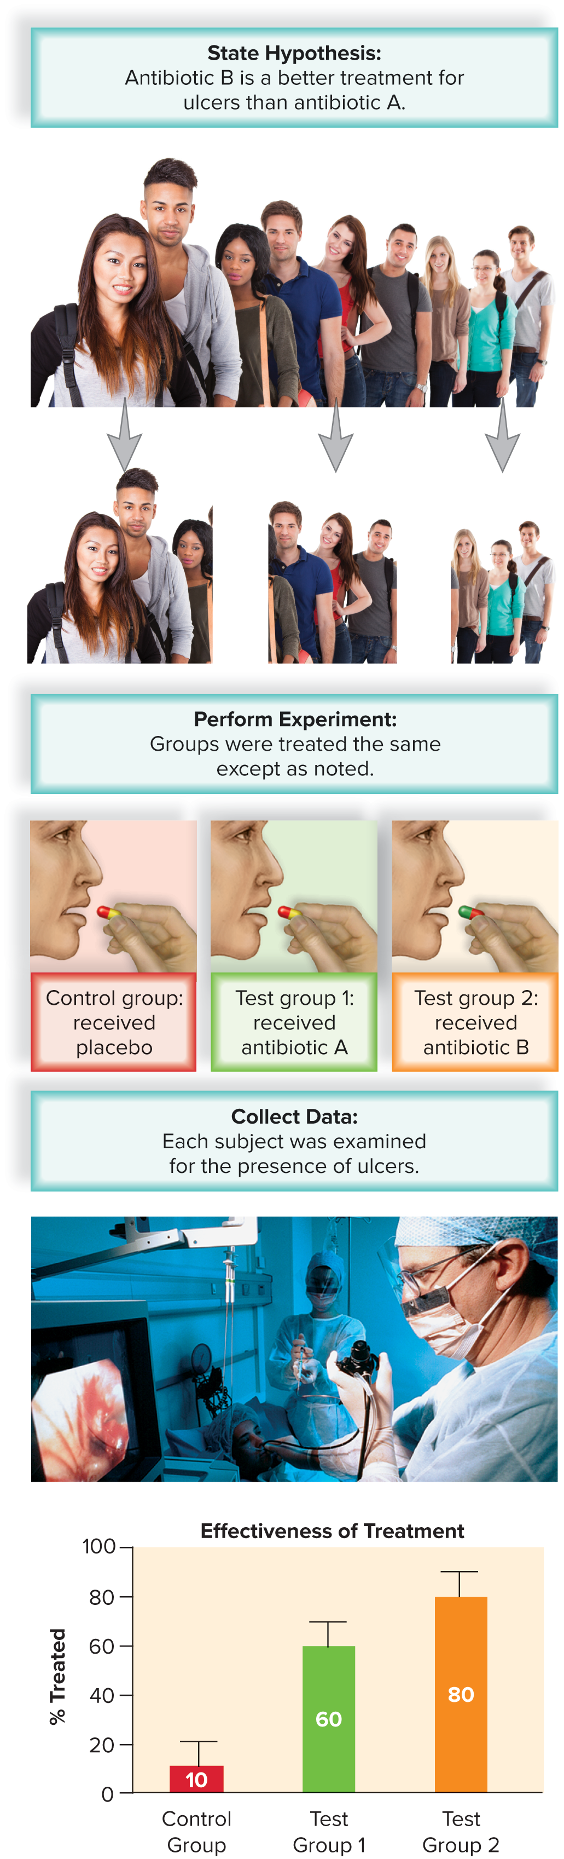
SCIENTIFIC METHOD EXAMPLE
Problem: Which of two antibiotics would best treat an ulcer?
Hypothesis: Antibiotic B is a better treatment for ulcers than antibiotic A.
Experimental process:
Control group – received placebo (no medication)
Group 1 – received antibiotic A
Group 2 – received antibiotic B
Data:
Control group – 10% improved
Group 1 – 60% improved
Group 2 – 80% improved
Results: Antibiotic B is a better treatment for ulcers. Hypothesis is supported.

Slide 33
POSSIBLE TEAS QUESTIONS
Which of the following is a hypothesis?
Five different breeds of dogs are at the dog park.
One liter of water was added to a reaction.
When I added fertilizer to my plants, they grew more quickly.
If a student gets more sleep, they will get a higher test score.
Why are control groups used in experiments?
To help scientists quickly perform experiments
To increase the amount of data collected
To ensure the accuracy of measurements
To minimize the effect of variables

Slide 34
POSSIBLE TEAS QUESTIONS
Which of the following is a hypothesis?
Five different breeds of dogs are at the dog park.
One liter of water was added to a reaction.
When I added fertilizer to my plants, they grew more quickly.
If a student gets more sleep, they will get a higher test score.
Why are control groups used in experiments?
To help scientists quickly perform experiments
To increase the amount of data collected
To ensure the accuracy of measurements
To minimize the effect of variables

Slide 35
POSSIBLE TEAS QUESTIONS
3. Dissolved oxygen (DO) is an important indicator of water quality, and oxygen levels that are too high or too low can harm aquatic ecosystems. A biologist noticed that fish were dying in a local lake and was concerned about the DO levels. To measure the DO levels, she brought back several lake water samples to her lab to measure the DO concentration as a function of temperature. To do this, she heated several samples to various temperatures while others were kept at the outdoors temperature. She then measured the DO concentrations in each sample.
Which of the following is the independent variable?
location of the lake
volume of water
temperature
dissolved oxygen concentration

Slide 36
POSSIBLE TEAS QUESTIONS
3. Dissolved oxygen (DO) is an important indicator of water quality, and oxygen levels that are too high or too low can harm aquatic ecosystems. A biologist noticed that fish were dying in a local lake and was concerned about the DO levels. To measure the DO levels, she brought back several lake water samples to her lab to measure the DO concentration as a function of temperature. To do this, she heated several samples to various temperatures while others were kept at the outdoors temperature. She then measured the DO concentrations in each sample.
Which of the following is the independent variable?
location of the lake
volume of water
temperature
dissolved oxygen concentration

Slide 37
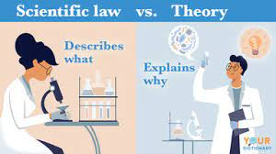
SCIENTIFIC THEORY VS SCIENTIFIC LAW
SCIENTIFIC THEORY
SCIENTIFIC LAW
Explains how or why something happens
Uses many observations and extensive experimental evidence
Can be applied to unrelated facts and new relationships
Can be modified if new data/evidence is introduced
Examples: Theory of Evolution, Cell Theory, Atomic Theory
Explains what is happening
Stands the test of time, often without change
Experimentally confirmed over and over
Can create true predictions for different situations
Uniform and universal
Examples: Law of Gravity, Law of Conservation of Mass, Newton’s Laws of Motion

Slide 38
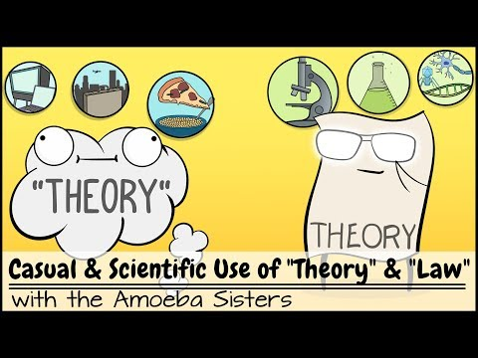
THEORY VS LAW

